Slide 1
MONTESANO LTC
FIRE & FULL EVACUATION
Lessons learned from a rural incident
Notes:
Elya

Slide 2
Panel Introductions & Response Role
Elena Madrid
Washington Health Care Association
LTC Coordination (Virtual)
Elya Baltazar, District Manager
Northwest Healthcare Response Network
Patient Tracking (Virtual)
Hannah Cleverly, Deputy Director
Grays Harbor Emergency Management
Emergency Manager (Remote)
Laura Hofmann
Leading Age
LTC Coordination (Virtual)
Leonard Johnson, Fire Chief
McLane Black Lake Fire Department
Medical Branch Director &
IC - Temporary Shelter
Mariah Pede, West District Coordinator
Northwest Healthcare Response Network
Duty Officer & EOC (Virtual)
Matt Miller, Fire Chief
Hoquiam Fire Department
Medical Group Supervisor at Medical Health and Rehab
Nick Falley, Program Manager
Grays Harbor County Emergency Management Duty Officer & EOC Manager
Notes:
Elya

Slide 3
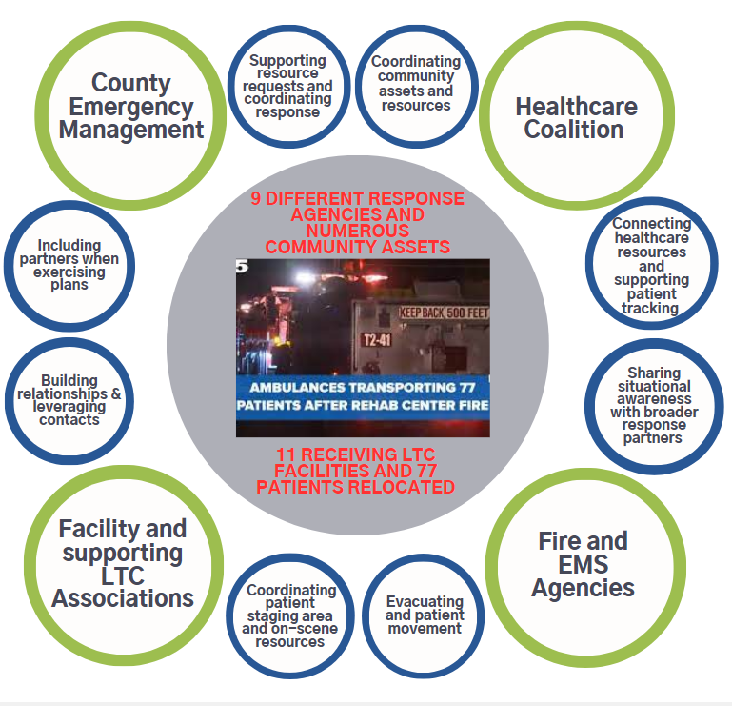
Why are we here?
Notes:
Elya

Slide 4

Notes:
Elya to play

Slide 5
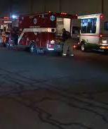
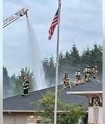
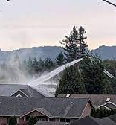
The
Incident
Wednesday, September 14, 2022
At 5:30 p.m. the Montesano Health & Rehab LTC Facility experienced a structure fire that ultimately impacting the entire facility.
Forced the evacuation of 77 residents and the facilities staff to an alternate shelter location.
Required the fire and EMS resources from Grays Harbor and 7 neighboring counties.
Activated the Emergency Operations Centers (EOCs) for both Grays Harbor & the NW Healthcare Response Network, opened the Disaster Medical Control Center at St. Peters Hospital.
Notes:
Nick Falley

Slide 6
September 14th timeline
5:30 PM
Fire broke out at Montesano Health and Rehab (MHR), with reports from the facility and area residents that smoke was coming from the building.
5:36 PM
Fire Dept arrived on scene. Staff at the facility had already begun evacuating patients to a nearby parking lot away from the structure.
6:16 PM
Administrator from MHR called the NWHRN Duty Officer to advise of the situation, alerting to a full evacuation and requesting support for patient relocation and logistics support for water, food, and portable oxygen.
6:20 PM
Additional outreach began to the broader healthcare response partners and supporting agencies (Emergency Management, Central Region Fire Defense, Leading Age, etc.)
7:21 PM
Local Disaster Medical Control Center was alerted and a plan for Teams Virtual EOC.
8:00 PM
Virtual EOC was activated with multiple response locations and on-site personnel joining, along with numerous remote response partners.
10:25 PM
Patient data and transportation information input began by NWHRN.
1:30 AM
All 77 patients were accounted for in the WATrac system and placement verified with receiving facilities, temporary shelter closed shortly after.
Notes:
Nick Falley

Slide 7
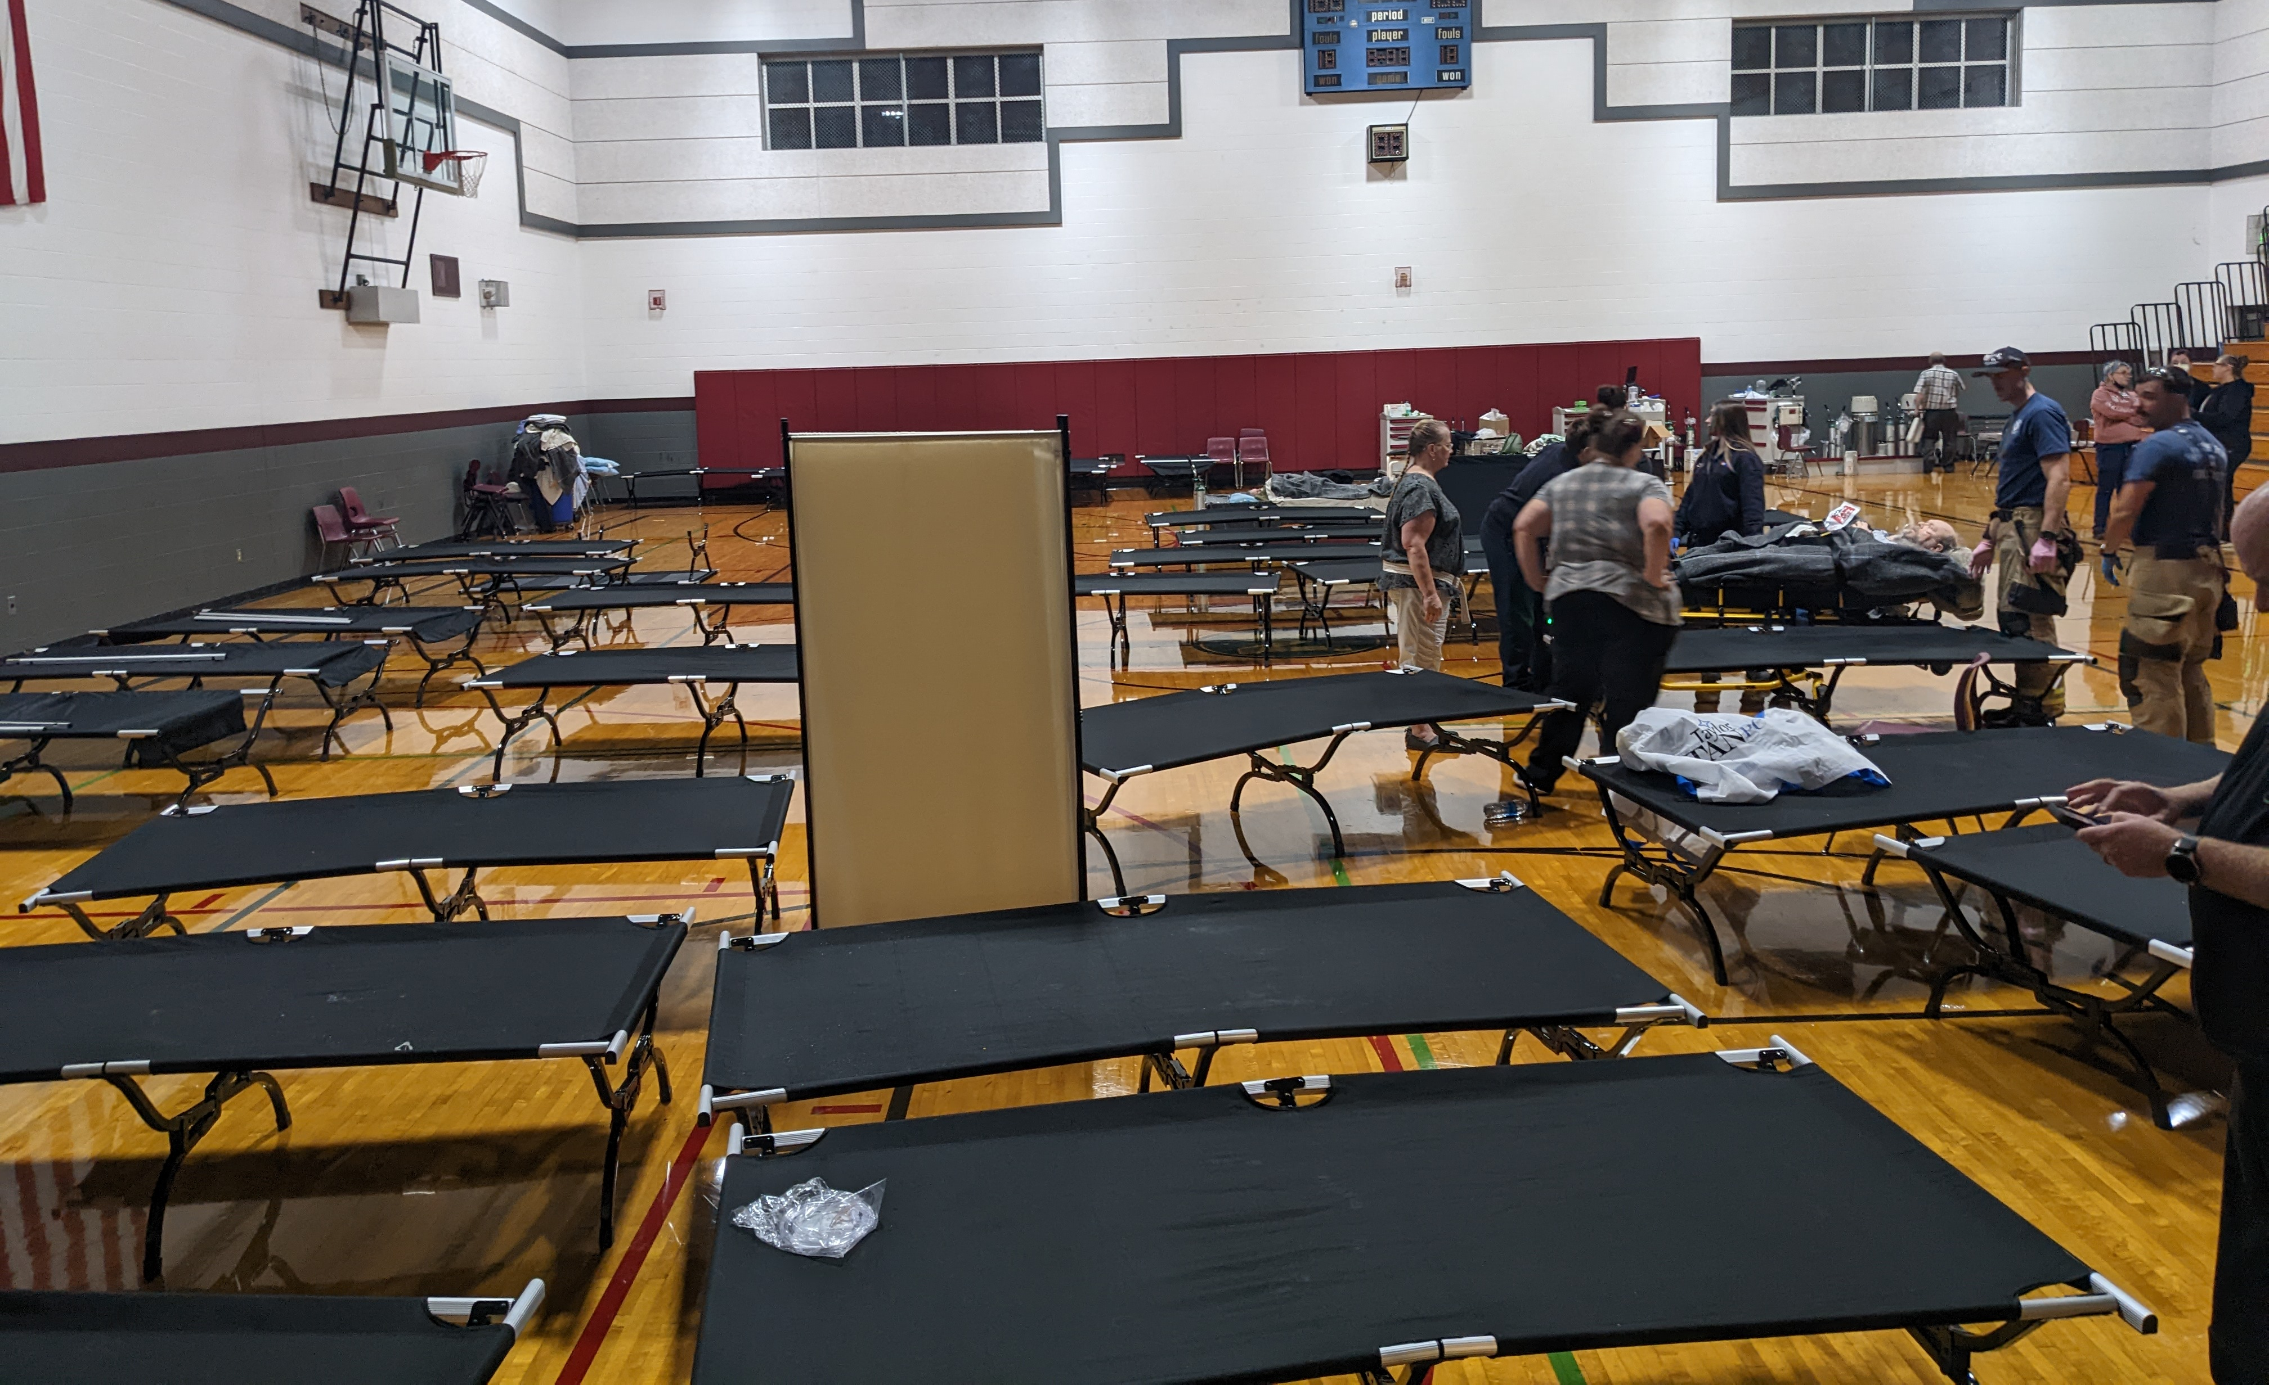
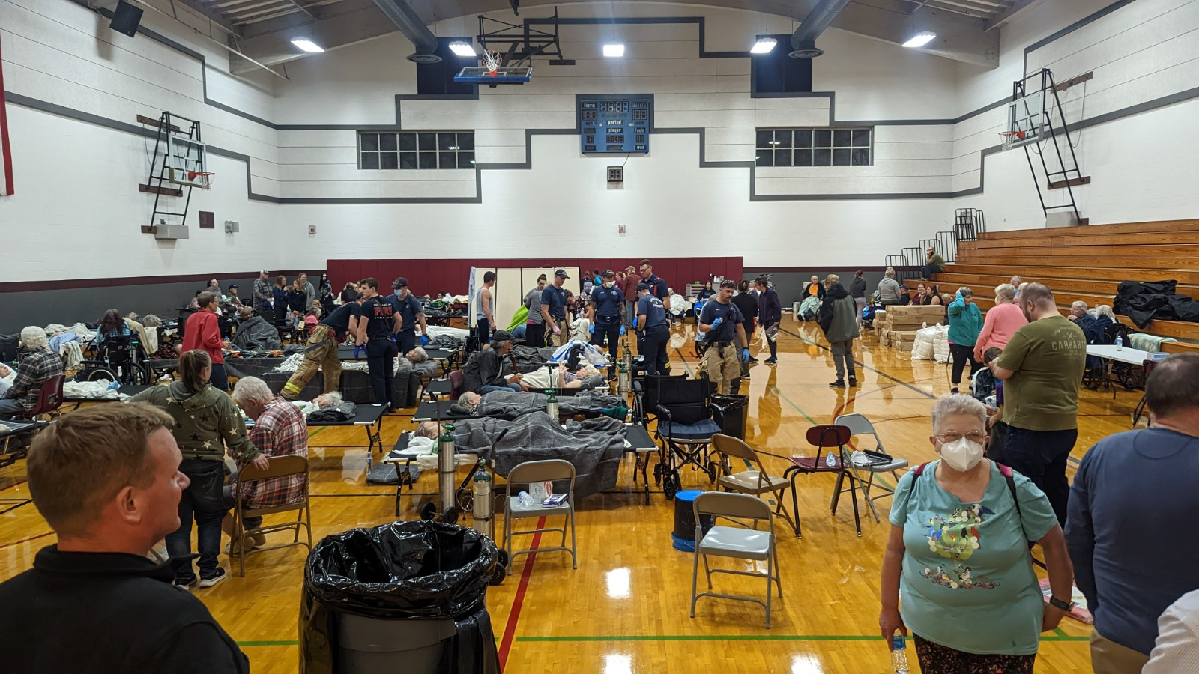
The Incident
Local Ambulances transported 7 patients to local hospitals for on-going care.
Established a temporary shelter for 70 residents.
Utilized ambulance and transit buses to relocate residents to 13 different facilities.
Over 27 ambulances and 9 Montesano School and Grays Harbor Transit buses assisted
Temporary Shelter –
Montesano Junior High School Gym
Notes:
Leonard Johnson

Slide 8

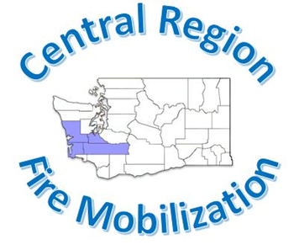
THE RESPONSE
Communications
Started early in the incident
Virtual EOC helped facilitate
Crisis communications plan
Relationships
Established before the incident
Pre-incident exercising of plans
Working Agreements
Roles & Responsibilities
EOC and Incident Personnel understood roles
Responding and requested resources knew their roles.
Keys to Success:
Communications
Relationships
Roles & Responsibilities
Notes:
Leonard Johnson

Slide 9
THE RESPONSE
Communications
Lack of formal request to Activate County EOC
Central Region failed to notify the county coordinators/mass notification
Lack of timely and accurate Public Information
Resource Ordering
Limited Resources in County
Mobilization of county EM resources
Right Resource – Right Task
People Management
Spontaneous Volunteers
Site Control / Security
Resident and Patient Tracking
Challenges:
Communications
Resource Ordering
People Management
Notes:
Leonard Johnson / Matt Miller at People Management

Slide 10
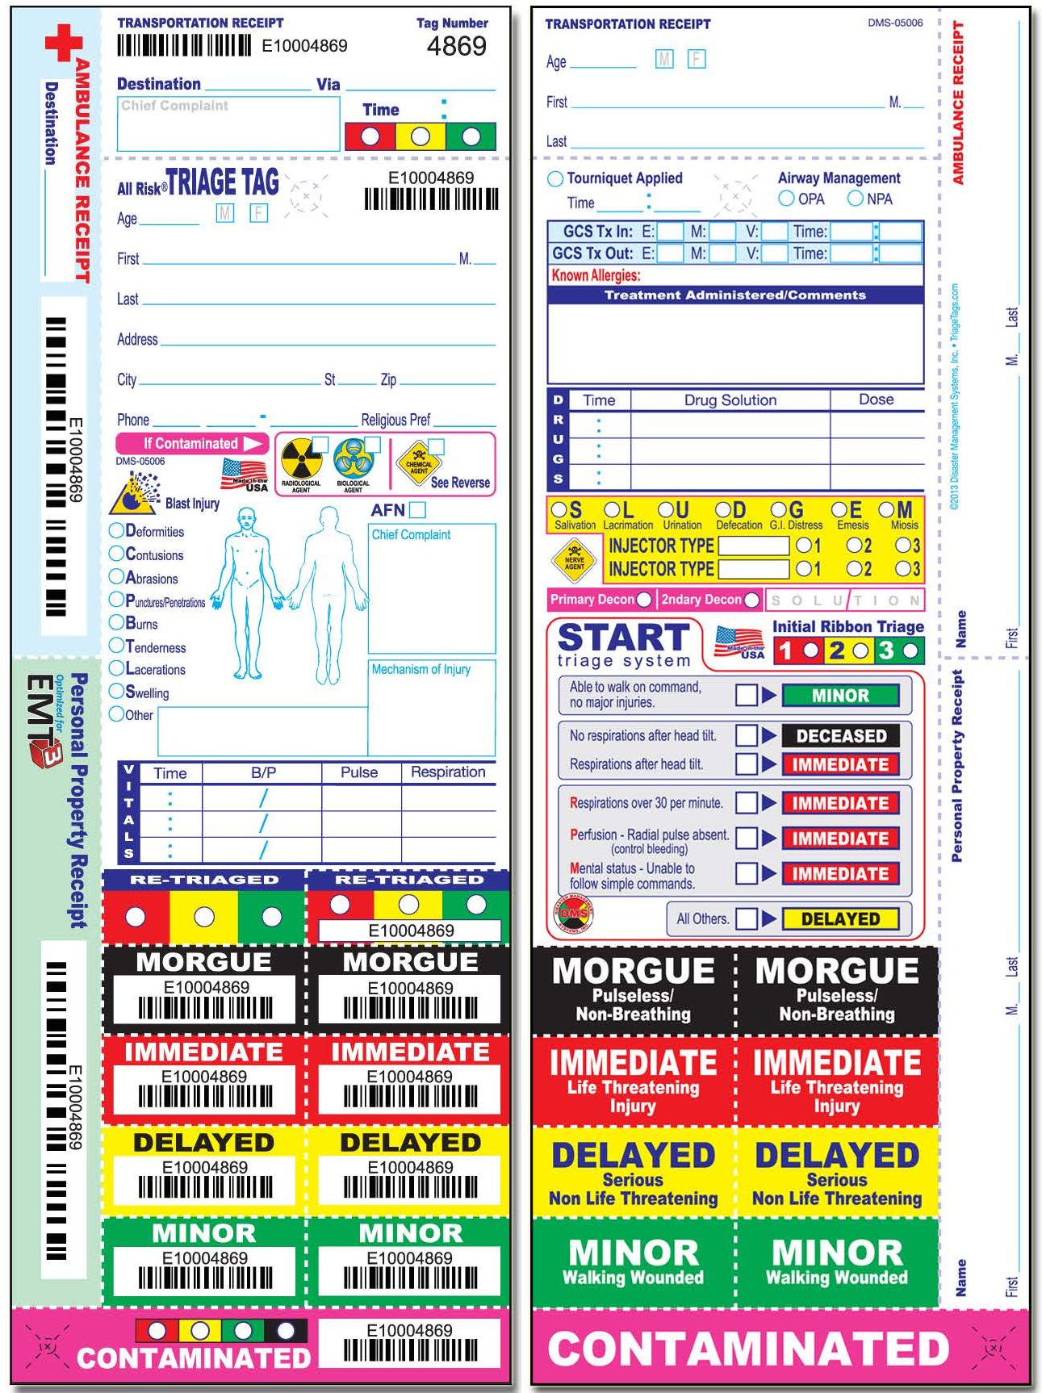
Residents were relocated to the following destinations:
Grays Harbor Health and Rehab - 13
Harbor Regional Health Hospital - 2
Linden - 18
Mason General Hospital - 1
Pacific Care - 13
Providence Centralia Hospital - 1
Puget Sound Health - 10
Shelton Pacific - 10
Summit Pacific Medical Center – 3
THE RESPONSE
Tracking & Accountability:
Failed to use standardized triage tracking/tag system
Need to establish & maintain communications between scene – temporary shelter.
Accountability of patient transport and receiving at facilities.
Challenges:
Communications
People Management
Notes:
Matt Miller

Slide 11
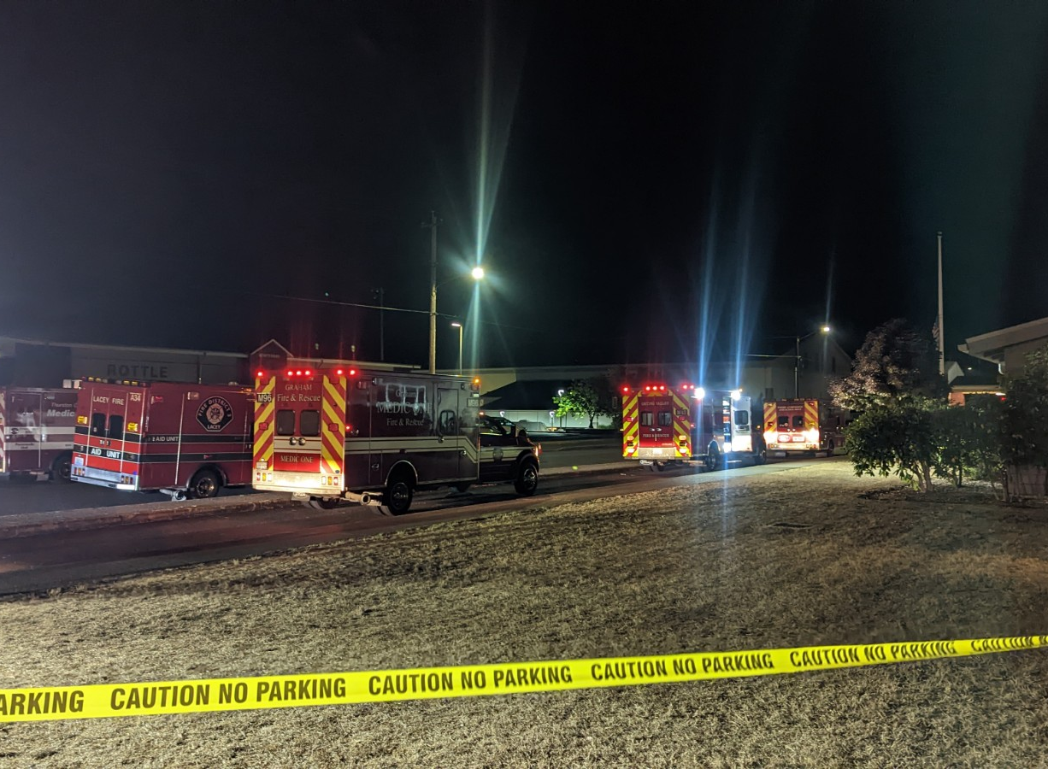
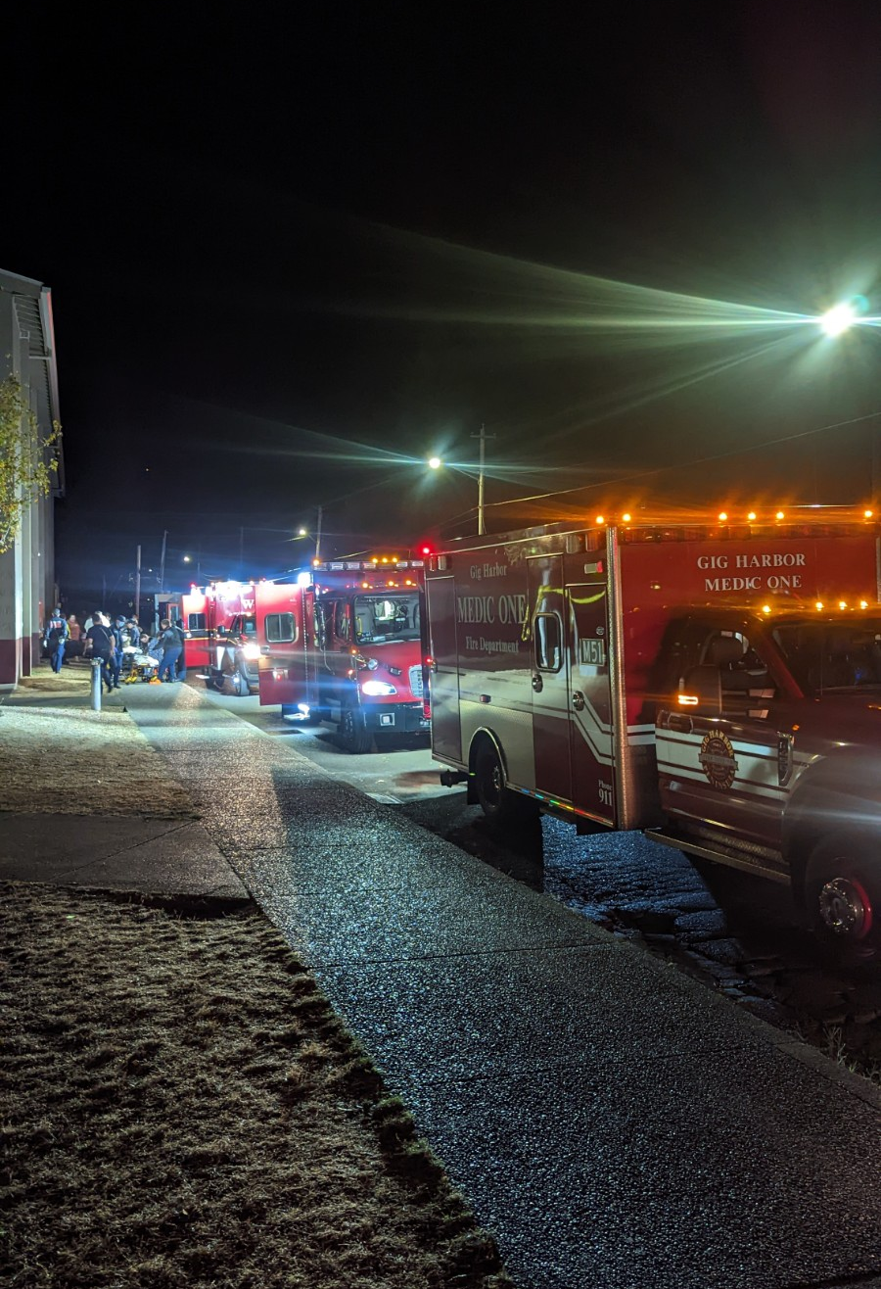
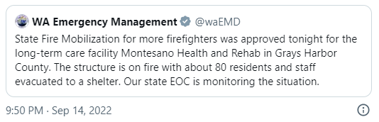
THE RESPONSE
All-Hazard WA Fire Mobilization Plan Response for providing resources
Know your plans and exercise them.
Notes:
Leonard Johnson

Slide 12


Critical Partner Support
Relationships
Get to know your partners before response
Lean in early to ask for support
Be willing to say yes!
Contact Info
Have 24/7 contact info
Think outside the box
Facility Plans
Create functional plans
Include partners in the planning process/review
Know your local resources
Utilize MOU’s
Keys to Success:
Relationships
Contact Info
Plans
Notes:
L

Slide 13
Critical Learnings
Have patient details on hand for evacuation.
Utilize virtual platforms to connect partners- this allowed for all partners to support and was highly effective. Provided clear communication and coordination, no delay in response due to drive time/traffic from the incident.
Plan for facility staff to work alongside responders-to support patient care in the holding area, provided critical patient information, supported appropriate placement based on needs, and verified accuracy on transportation.
Ensure you have contacts and planning information ahead of a response. It is optimal for facilities/agencies/organizations to speak, meet, or be part of coalition and the community conversations before working alongside each other during stress/crisis. Build your relationships and plans BEFORE response! Additionally, make sure you have 24/7 contacts or cell numbers.
WATrac was key for all the agencies involved in patient movement and care. Many of the fire departments and long-term care facilities involved had not previously used this platform. This caused some delay, additional time/manpower to input them into the system. Reach out to the Network to get added to WATrac before you have the need to use it. This was the first time WATrac was used for a LTC evacuation/relocation/patient tracking incident. It was highly useful in family reunification and coordination with all the receiving partners and command post on site.

Slide 14
What’s next?
Planning – plan for who is likely to be in your building/facility and how to help them evacuate. Patient info, critical documents, supporting patient care
Coordinating – understand how response works in your community and where you plug-in. Who are the response agencies, current meetings, resources
Tracking – WATrac is one solution (figure out what works for you if you aren’t in healthcare)
In total, there were 77 displaced patients requiring various levels of care, all of which were successfully transferred to appropriate facilities and/or discharged home where possible. 11 Long Term Care Facilities supported relocation and received patients from MHR, alongside numerous response partners who rapidly came to the aid of this facility and community by offering resources, staff, and expertise.

Slide 15
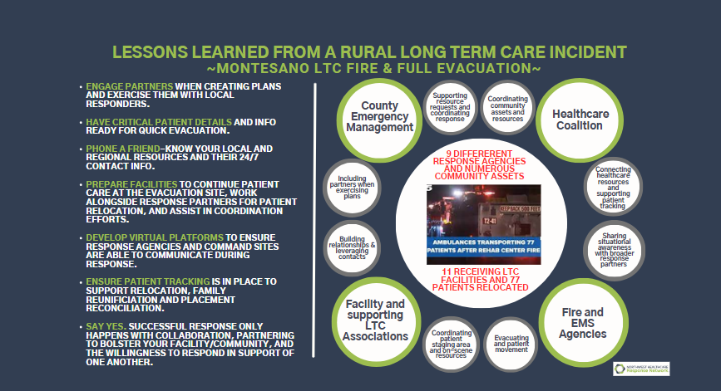

Slide 16
On behalf of all who were involved, we want to thank each one for the support provided to one another as response colleagues and the incredible care exhibited for these patients!
QUESTIONS?

